Slide 1


ISI4E3-English for Academic Writing Purposes
Concise Writing
Department of Information System
School of Industrial Engineering
Telkom University
Notes:
Hello everyone. My name is Ima Normalia Kusmayanti. My students call me Miss Ima. Let’s learn English for Academic Writing Purposes. In these slides, I will explain to you about concise writing.

Slide 2
Course Learning Outcomes - CLOs
CLO 01
CLO 02
CLO 03
use simple and compound sentences in present and past tenses, present continuous, and present perfect tense to present some interesting facts about skills and abilities in the form of a short paragraph with “intermediate mid” fluency level.
use simple, compound, and complex sentences in present tense, present continuous tense, and present perfect tense to present interesting facts about the roles of information system in our lives today in the form of a short paragraph with “intermediate-high” fluency level.
state their opinions with relevant and interesting proofs related to their innovative technology creations in the form of 3-5 paragraph essay using present tense, present continuous tense, present perfect tense, and past tense with “low-advanced” fluency level.
Notes:
This is the fourth lesson that will help you achieve the second course learning outcome.

Slide 3
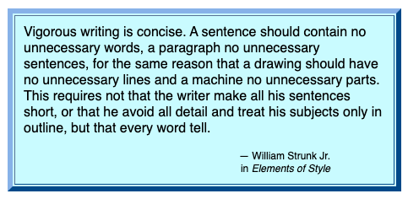
Picture is downloaded from http://guidetogrammar.org/grammar/concise.htm
Notes:
Here is one famous quote about concise writing from William Strunk Junior, in his book Elements of Style. Vigorous writing is concise. A sentence should contain no unnecessary words, a paragraph no unnecessary sentences, for the same reason that a drawing should have no unnecessary lines and a machine no unnecessary parts. This requires not that the writer make all his sentences short, or that he avoid all detail and treat his subjects only in outline, but that every word tell.

Slide 4
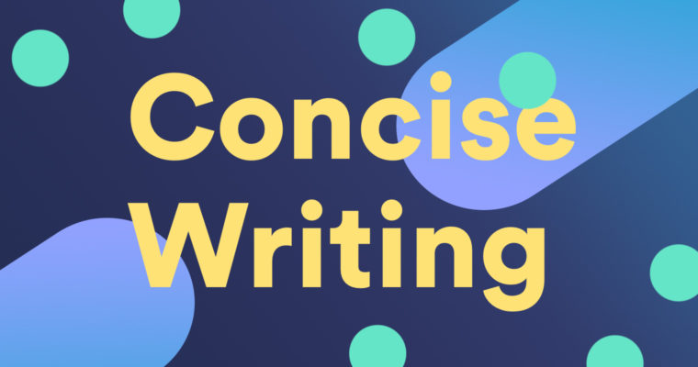
Reducing wordiness
Picture is downloaded from https://www.grammarly.com/blog/what-is-concise-writing/?utm_source=google&utm_medium=cpc&utm_campaign=searchgroupegrammardsa&utm_targetid=dsa-913938104616&gclid=EAIaIQobChMIz-f_m-zs6wIV1w0rCh1oVgUQEAAYASAAEgI7kvD_BwE
Notes:
What is concise writing? Concise writing means using the fewest words possible to convey an idea clearly. I recommend you to practice writing concisely to grab and hold your reader’s attention. Concise writing also likely to be more memorable and make a lasting impact on your reader.

Slide 5
3 Techniques
Eliminate Redundant Words
Eliminate Unnecessary Words and Phrases
Construct Active Sentences
Notes:
There are at least three techniques to make your sentences to be more concise.

Slide 6

Paraphrased Paragraph
Information Systems refine the entire efficiency and effectiveness of bank transactions. For instance, Automatic Teller Machines and Bank Debit Cards were developed in 1977, made financial transactions easy and were an immense triumph. Further, banks continued to innovate. Majority of customers can do most transactions from their home computer. Even they can do bank transactions from mobile telephone with more reliable and secure information system. Moreover, information systems supply real time information reducing the scope of errors. Hence, the real time information increases the quality of the process output. These examples prove the importance of information systems in our lives.
100 words
Notes:
Let’s learn and practice these three techniques to make your sentences to be more concise. As you can see, the word count for this paragraph is 100 words.

Slide 7
Eliminate Redundant Words
Wordy | Concise
Majority of customers can do most transactions from their home computer. Even they can do bank transactions from mobile telephone with more reliable and secure information system. | Most customers can do bank transactions from their home computer and mobile telephone with reliable and secure information system.
27 words
19 words
Notes:
This is an example of reducing words by eliminating redundant words.

Slide 8
Eliminate Unnecessary Words
Wordy | Concise
Information Systems refine the entire efficiency and effectiveness of bank transactions. | Information Systems refine bank transactions’ efficiency and effectiveness.
11 words
8 words
Notes:
This is an example of reducing words by eliminating unnecessary words.

Slide 9
Eliminate Unnecessary Phrases
Wordy | Concise
Moreover, information systems supply real time information reducing the scope of errors. | Moreover, information systems supply real time information reducing errors.
12 words
9 words
Notes:
This is an example of reducing words by eliminating unnecessary phrases.

Slide 10
Construct Active Sentences
Wordy | Concise
For instance, Automatic Teller Machines and Bank Debit Cards were developed in 1977 (by Citibank). | For instance, Citibank developed Automatic Teller Machines and Bank Debit Cards in 1977.
13 (15) words
13 words
Notes:
This is an example of reducing words by constructing active sentences.

Slide 11
Paraphrased Paragraph
Information Systems refine bank transactions’ efficiency and effectiveness. For instance, Citibank developed Automatic Teller Machines and Bank Debit Cards in 1977, made financial transactions easy and were an immense triumph. Further, banks continued to innovate. Most customers can do bank transactions from their home computer and mobile telephone with reliable and secure information system. Moreover, information systems supply real time information reducing errors. Hence, the real time information increases the quality of the process output. These examples prove the importance of information systems in our lives.
86 words
Notes:
As you can see now, by doing the three techniques to reduce wordiness, now, the word count of this paragraph is 86 words.

Slide 12
3 Techniques
Eliminate Redundant Words
Eliminate Unnecessary Words and Phrases
Construct Active Sentences
Notes:
Now you have learned and practiced the three techniques to make your sentences to be more concise.

Slide 13

Picture is downloaded from https://quotesgram.com/quotes-about-language-learning/
Notes:
This is the end for the slides of concise writing. I hope by now, you are familiar with several techniques to reduce wordiness. As Frank Smith said “one language sets you in a corridor for life. Two languages open every door along the way”. Good luck!

